Slide 1
E-AUCTION
Bid It To Win It
Aniket chikane
Prajwal banker
Samadhan Deshmukh
Dange Rahul
Abhishekh Dhanapune
Guided by:-
Prof J. N. Ganthade

Slide 2

PROJECT OBJECTIVE
Objective behind this project is to provide an easy and effective way to bidders , Who are willing to turn their money into asset.
Here they find each and everything which they are looking for . We kept each and every aspects of bidders into our mind and try to fix everything user friendly.
The project has been designed to simulate the working of an actual E- auction site.

Slide 3

PROJECT SCOPE
▶ Purchasing and selling products and services over the internet without the need of going physically to the auction site is what E-auction all about.
▶ E-auction has made auction less hectic and more interesting.
▶ Here product description, pictures, price and much more is provided.
▶ What bidders all need is to just sign-up and bid for their voluntary product within the bidding time.

Slide 4

REQUIREMENT SPECIFICATION
1. Software Requirements
▶ Operating system :- Windows server or any compatible server OS
▶Framework :- .Net framework 4.0
▶ Web Server :- XAMPP
▶ Front End:- HTML
▶ Back End :- SQL,JAVA,PHP
▶ Operating system :- Windows 10 or any compatible
▶ OS
▶ Browser :- Internet Explorer or any
▶ compatible

Slide 5

What is ASP ?
▶ Active Server Pages (ASP), also known as Classic ASP, is a Microsoft's server-side technology, which helps in creating dynamic and user-friendly Web pages. It uses different scripting languages to create dynamic Web pages, which can be run on any type of browser. The Web pages are built by using either VBScript or JavaScript and these Web pages have access to the same services as Windows application, including ADO (ActiveX Data Objects) for database access, SMTP (Simple Mail Transfer Protocol) for e- mail, and the entire COM (Component Object Model) structure used in the Windows environment. ASP is implemented through a dynamic-link library (asp.dll) that is called by the IIS server when a Web page is requested from the server

Slide 6
FUNCTIONAL REQUIREMENT
▶ ADMIN
▶ UPDATION: Admin has access to update products and category.
▶ REGISTRATION: registering users having valid id.
▶ DECLARING WINNER: user with highest bid should be allowed winner.
▶ DELETION: Deleting products which has been sold out.
▶ GUEST
▶ VIEW: visitors can see the products.
▶ REGISTER: can register if interested.
▶ MEMBER
▶ VIEW: Can view products.
▶ BID: Bid for the products, in which they are interested.
▶ LOGIN: Can login once registered.

Slide 7
Hardware Requirements (Minimum):-
Server side:-
Client side:-
ITEM | NEEDED
Processor | 2.20 GHz
RAM | 2GB
Hard disk | 10 GB Free Space
Processor | 2.0 GHz
Hard disk | 4 GB Free Space
ITEM | NEEDED
RAM | 2GB
Processor | 2.0 GHz
Hard disk | 4 GB Free Space

Slide 8
Software Requirements (Minimum)
Client side:-
Server side:-
ITEM | NEEDED
O.S | Windows server or any other compatible server OS
Framework | .Net framework 4.0
Web Server | IIS 6.0
Back End | SQL server 2016
Browser | Internet Explorer or any Compatible
ITEM | NEEDED
Operating system | Windows 10 or any compatible OS
Browser | Google chrome or any compatible

Slide 9

DRAWBACKS OF TRADITIONAL BIDDING MODEL
It was time consuming and very hectic.
Bidders had to physical present there during the time of bidding.
There were scopes of fixing and other illegal activities.
No assurance of good to be in proper condition .
Con men were highly active .

Slide 10

HOW E-AUCTION IS THE ANSWER
▶ Provides a global platform for bidders by getting it to masses
▶ Any interested party can put their goods for auction.
▶ Large number of bidders
▶ Large number of sellers
▶ No need to be physically present there for the bidders
▶ Transactions are safe as it safeguard both the parties

Slide 11
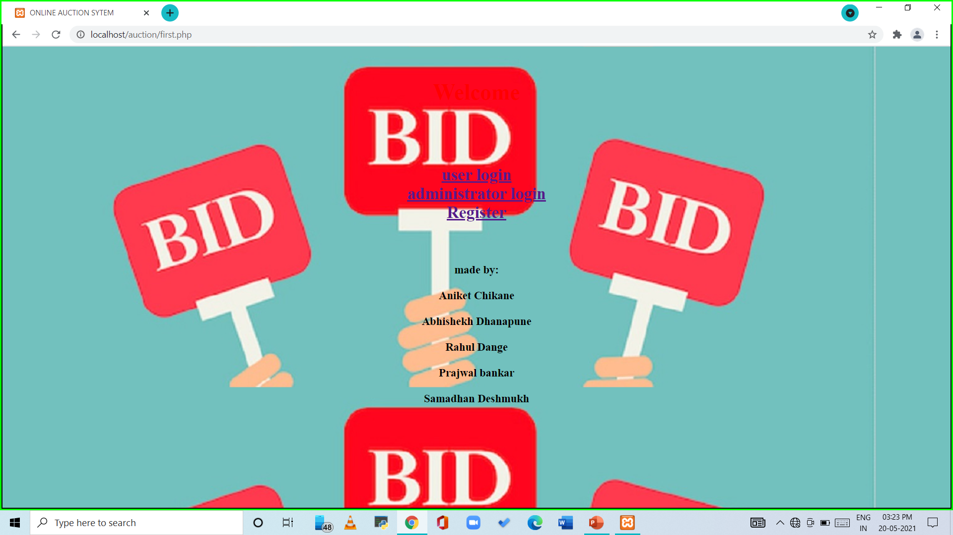

Slide 12
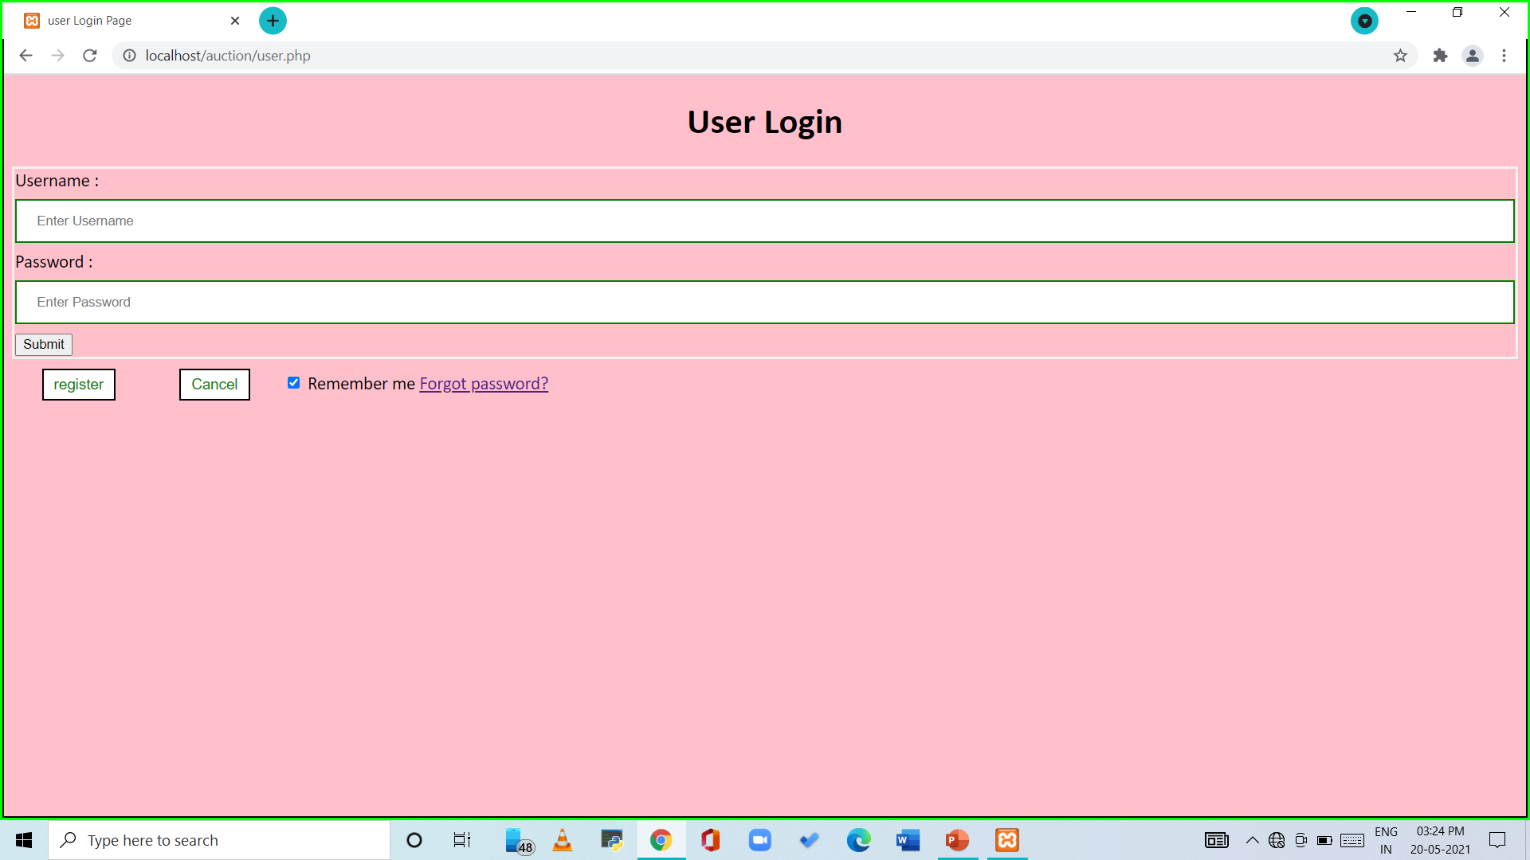

Slide 13
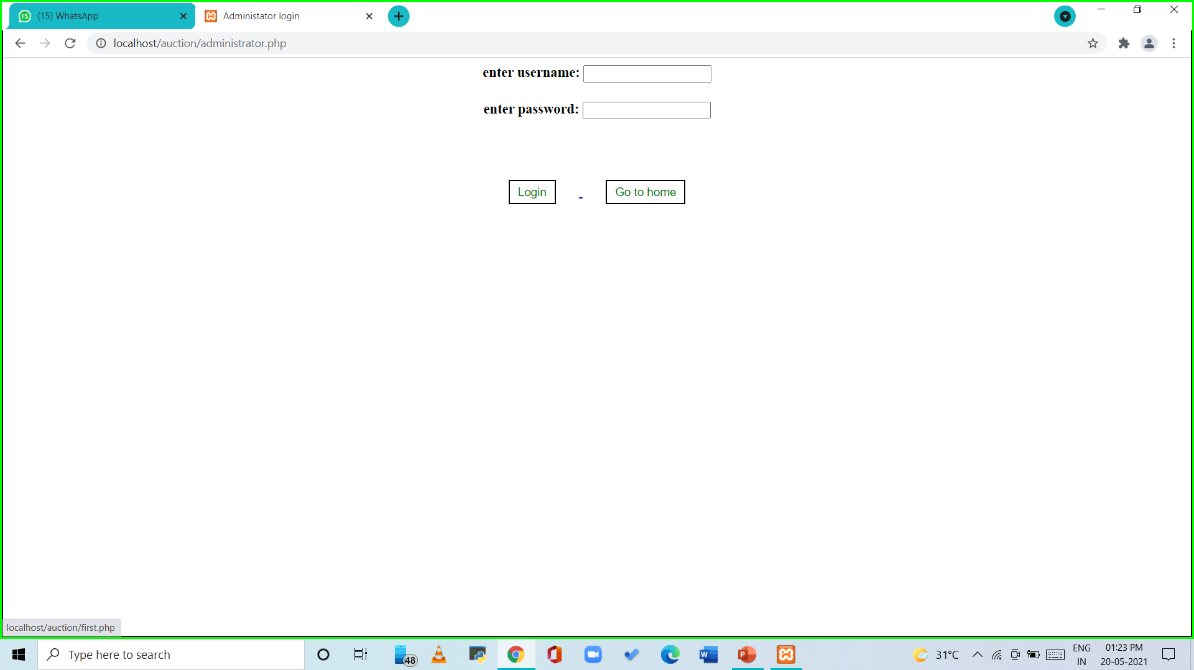
Administator login:-

Slide 14
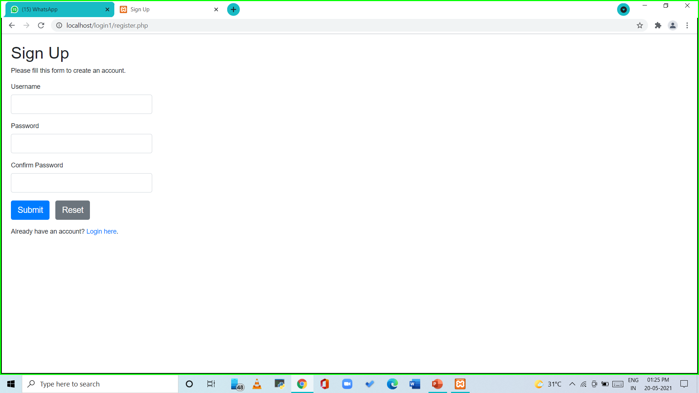
Registration form:-

Slide 15
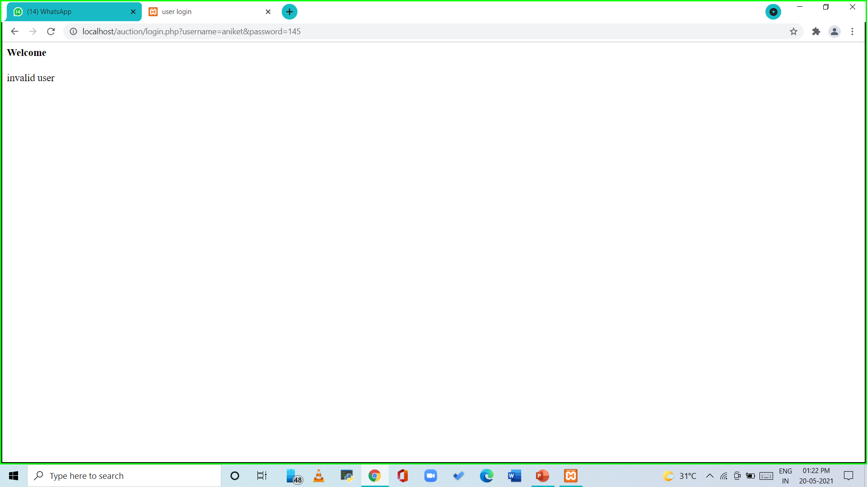
If username or password incorrect:-

Slide 16
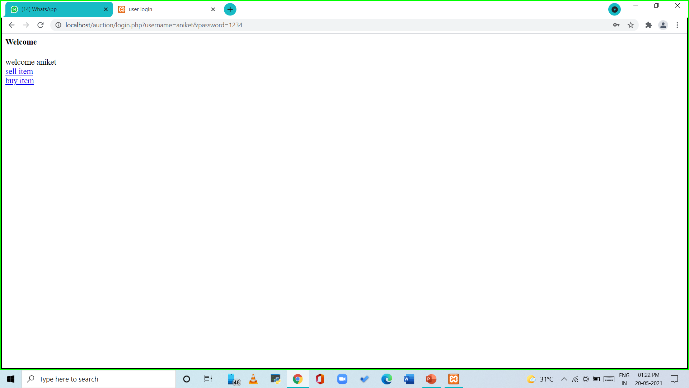
User login:-

Slide 17
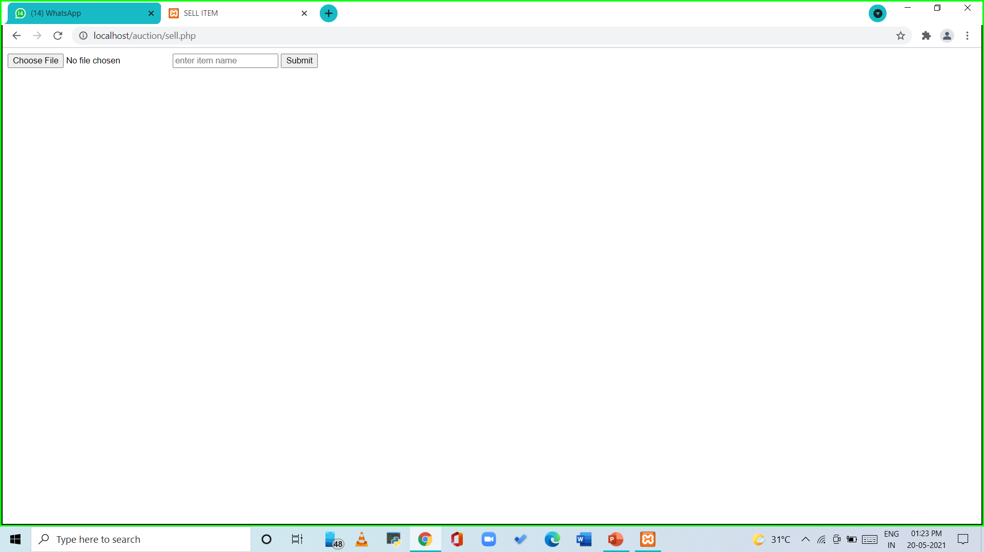
To sell product:-

Slide 18
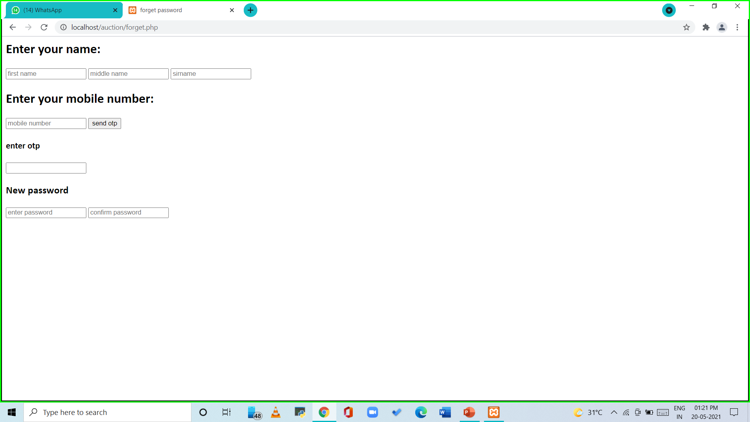
To reset password:-

Slide 19
References:-
Google
Youtube

Slide 20
THANK YOU

